Slide 1

Probability theory
Notes on Behavioural Economics
Jason Collins

Slide 2
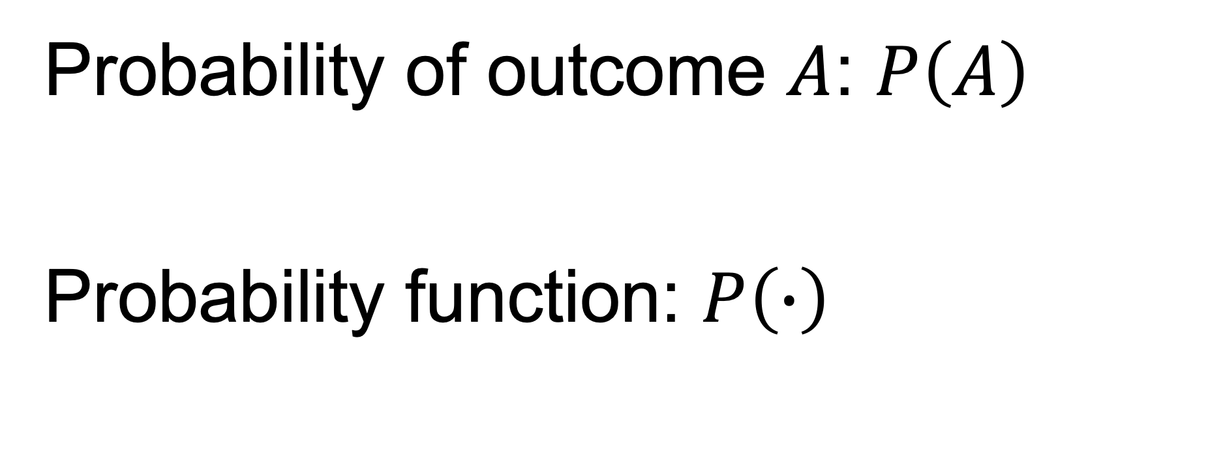
Probability of outcome $A$: $P\left(A\right)$
Probability function: $P\left(∙\right)$

Slide 3
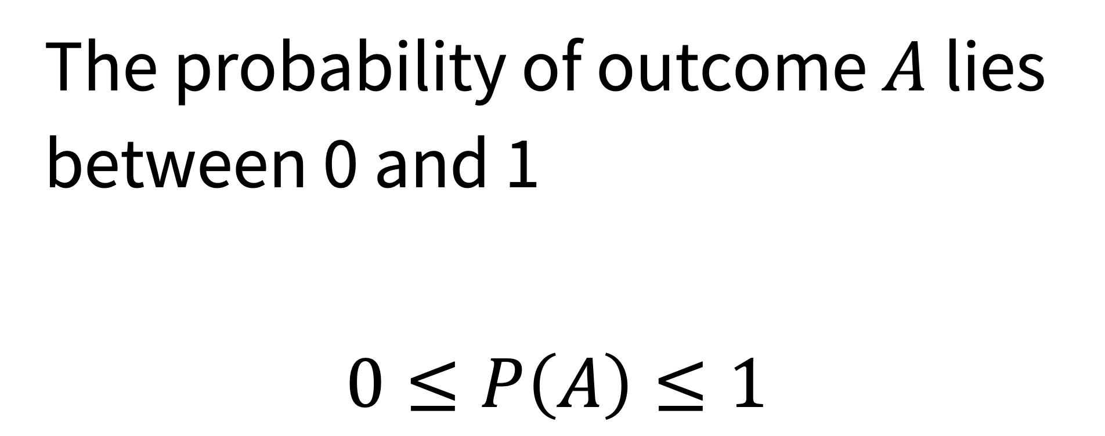
The probability of outcome $A$ lies between 0 and 1
$$0≤P\left(A\right)≤1$$

Slide 4
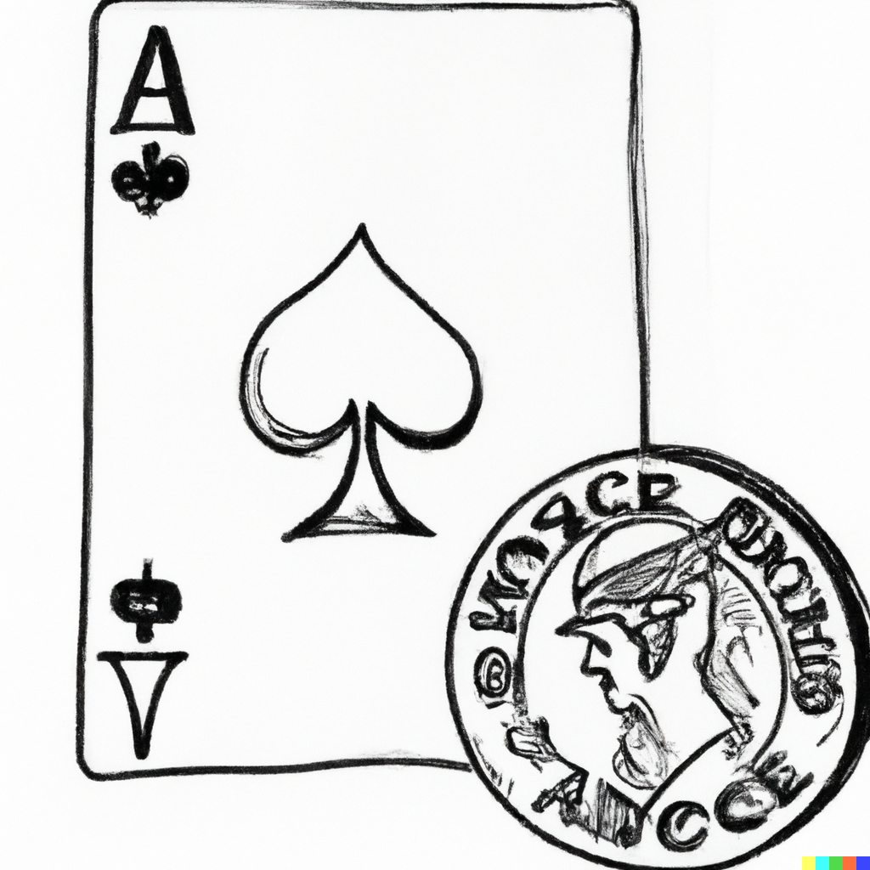

Slide 5

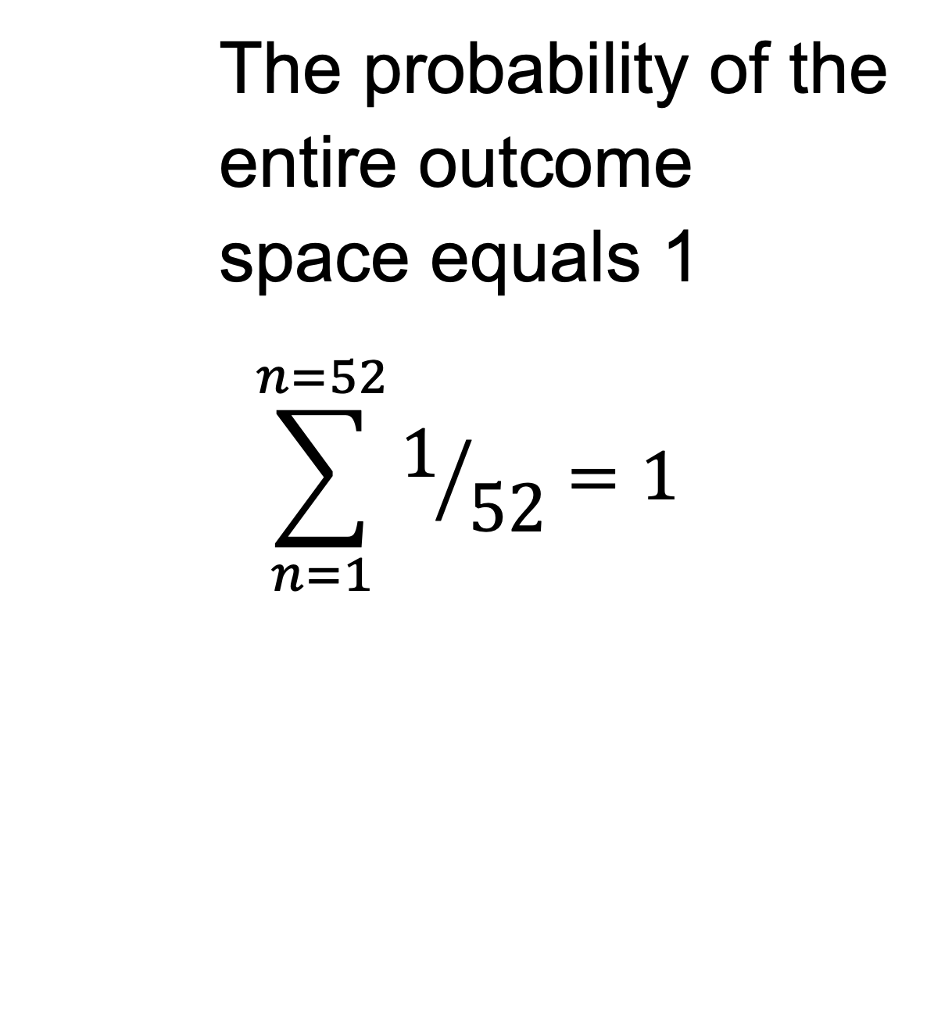
The probability of the entire outcome space equals 1
$$\sum_{n=1}^{n=52}{1/{52}}=1$$

Slide 6
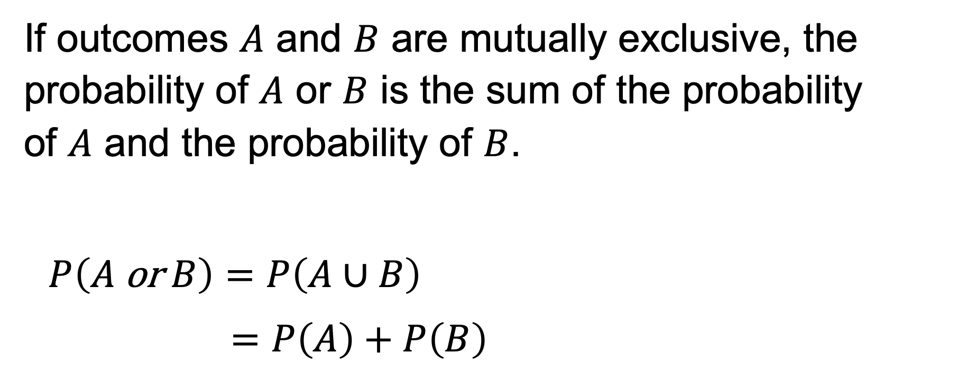
If outcomes $A$ and $B$ are mutually exclusive, the probability of $A$ or $B$ is the sum of the probability of $A$ and the probability of $B$.
$$P\left(A \text{or} B\right)=P\left(A∪B\right)$$
$$=P\left(A\right)+P\left(B\right)$$

Slide 7
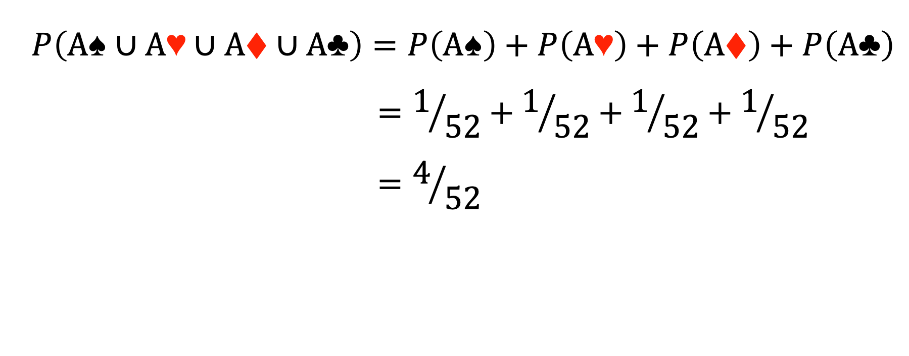
$$P\left(A♠️∪A\text{♥️}∪A♦️∪A\text{♣️}\right)=P\left(A♠️\right)+P\left(A\text{♥️}\right)+P\left(A♦️\right)+P\left(A\text{♣️}\right)$$
$$=1/{52}+1/{52}+1/{52}+1/{52}$$
$$=4/{52}$$

Slide 8
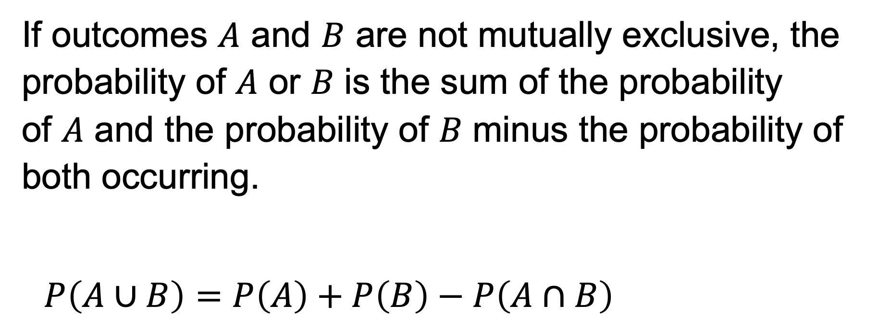
If outcomes $A$ and $B$ are not mutually exclusive, the probability of 𝐴 or 𝐵 is the sum of the probability of 𝐴 and the probability of 𝐵 minus the probability of both occurring.
$$P\left(A∪B\right)=P\left(A\right)+P\left(B\right)−P\left(A∩B\right)$$

Slide 9
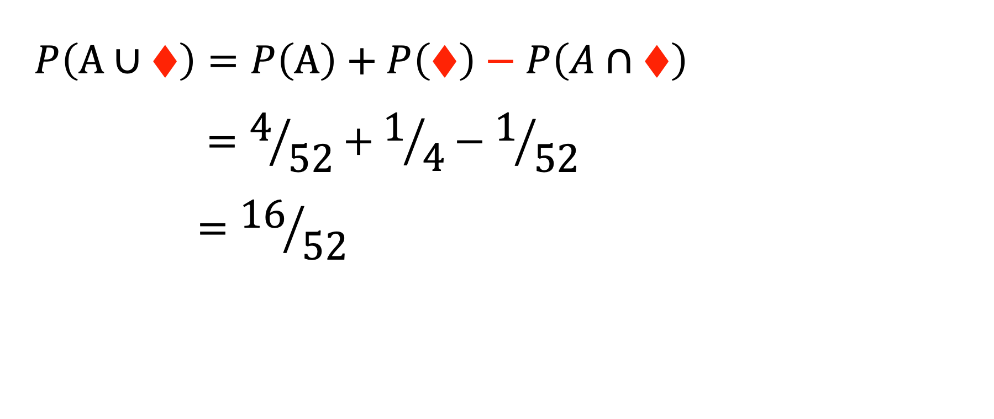
$$P\left(A∪♦️\right)=P\left(A\right)+P\left(♦️\right)−P\left(A∩♦️\right)$$
$$=4/{52}+1/4−1/{52}$$
$$={16}/{52}$$

Slide 10
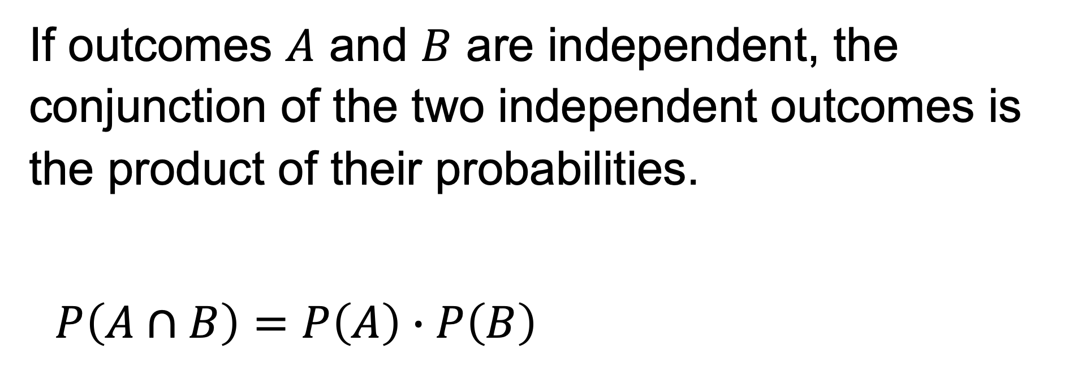
If outcomes $A$ and $B$ are independent, the conjunction of the two independent outcomes is the product of their probabilities.
$$P\left(A∩B\right)=P\left(A\right)∙P\left(B\right)$$

Slide 11
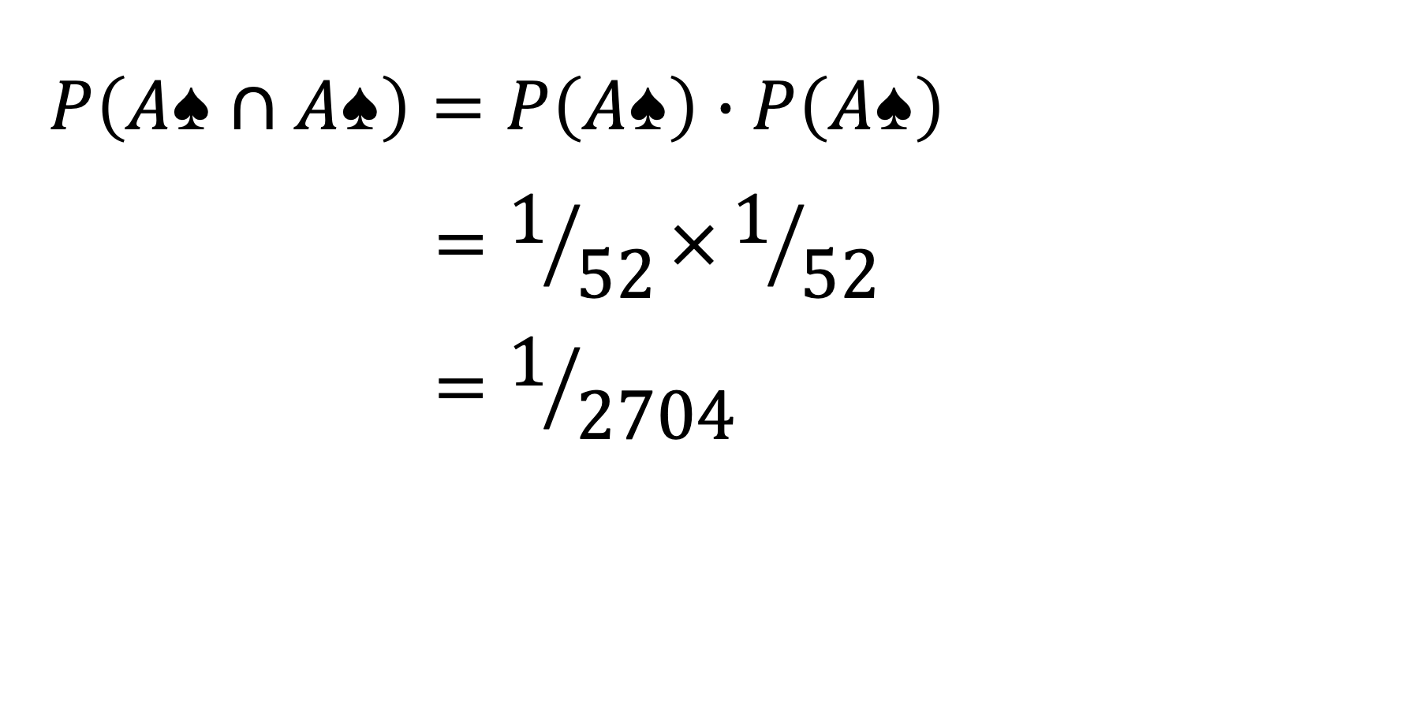
$$P\left(A♠️∩A♠️\right)=P\left(A♠️\right)∙P\left(A♠️\right)$$
$$=1/{52}×1/{52}$$
$$=1/{2704}$$

Slide 12
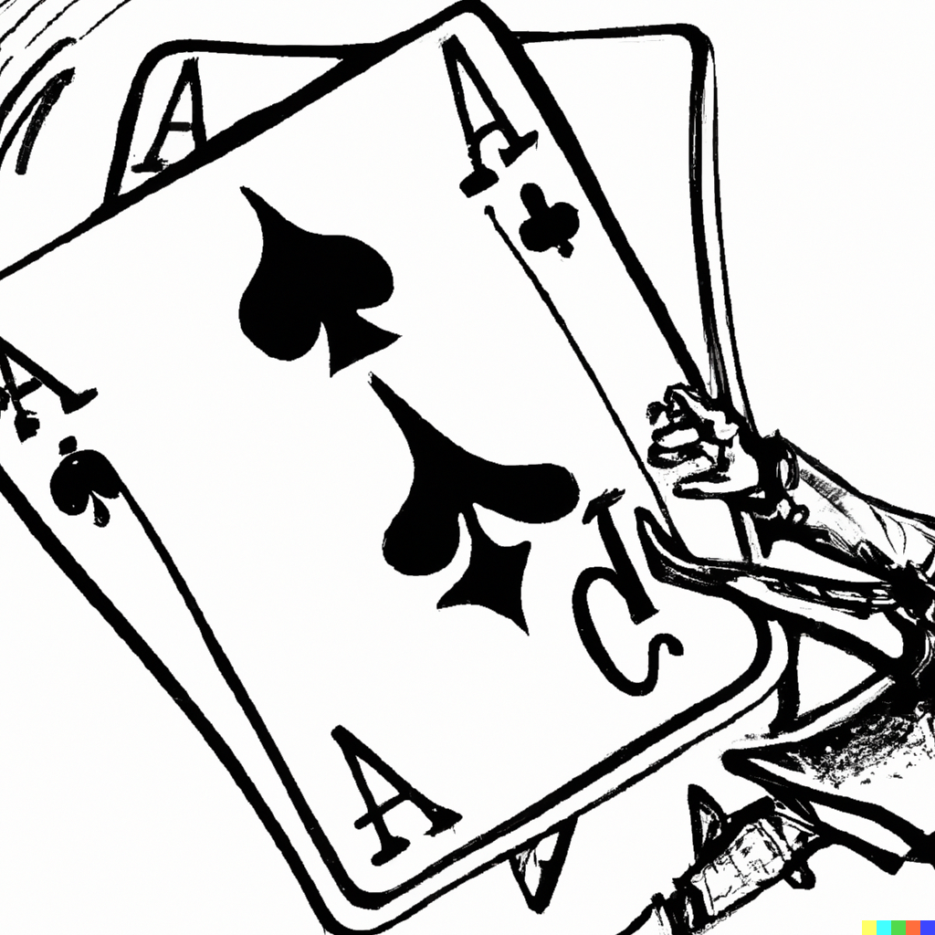

Slide 13
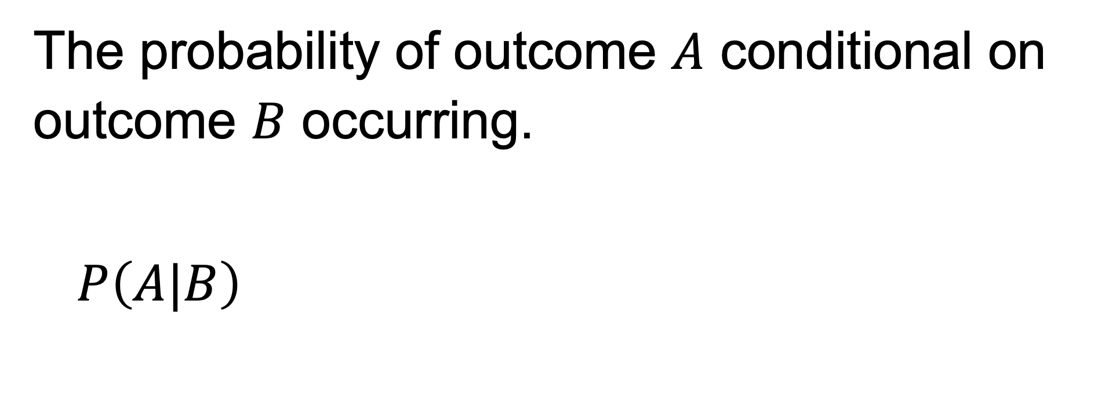
The probability of outcome $A$ conditional on outcome $B$ occurring.
$$P\left(A|B\right)$$

Slide 14
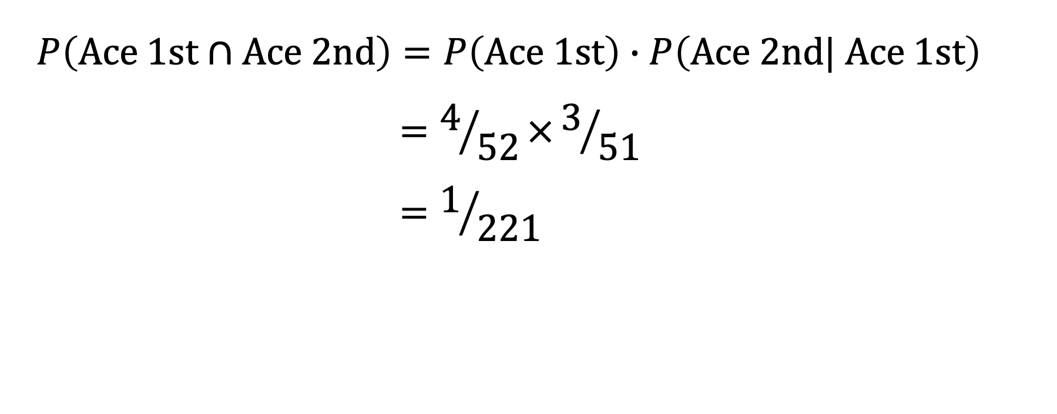
$$P\left(A\text{ce} \text{1}\text{st}∩\text{A}\text{ce} 2nd\right)=P\left(Ace \text{1}\text{st}\right)∙P\left(\text{A}\text{ce} 2nd| Ace \text{1}\text{st}\right)$$
$$=4/{52}×3/{51}$$
$$=1/{221}$$

Slide 15
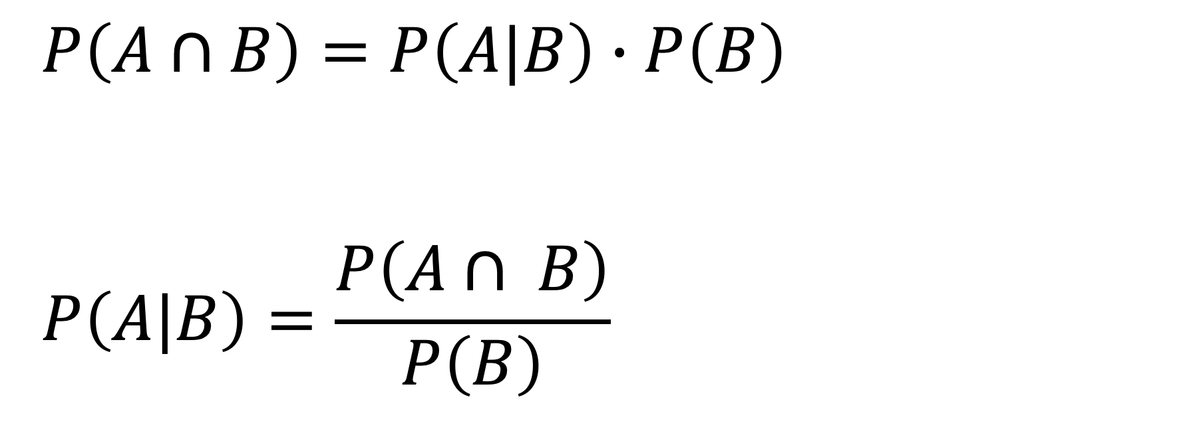
$$P\left(A∩B\right)=P\left(A|B\right)∙P\left(B\right)$$
$$P\left(A|B\right)=\frac{P\left(A∩ B\right)}{P\left(B\right)}$$

Slide 16
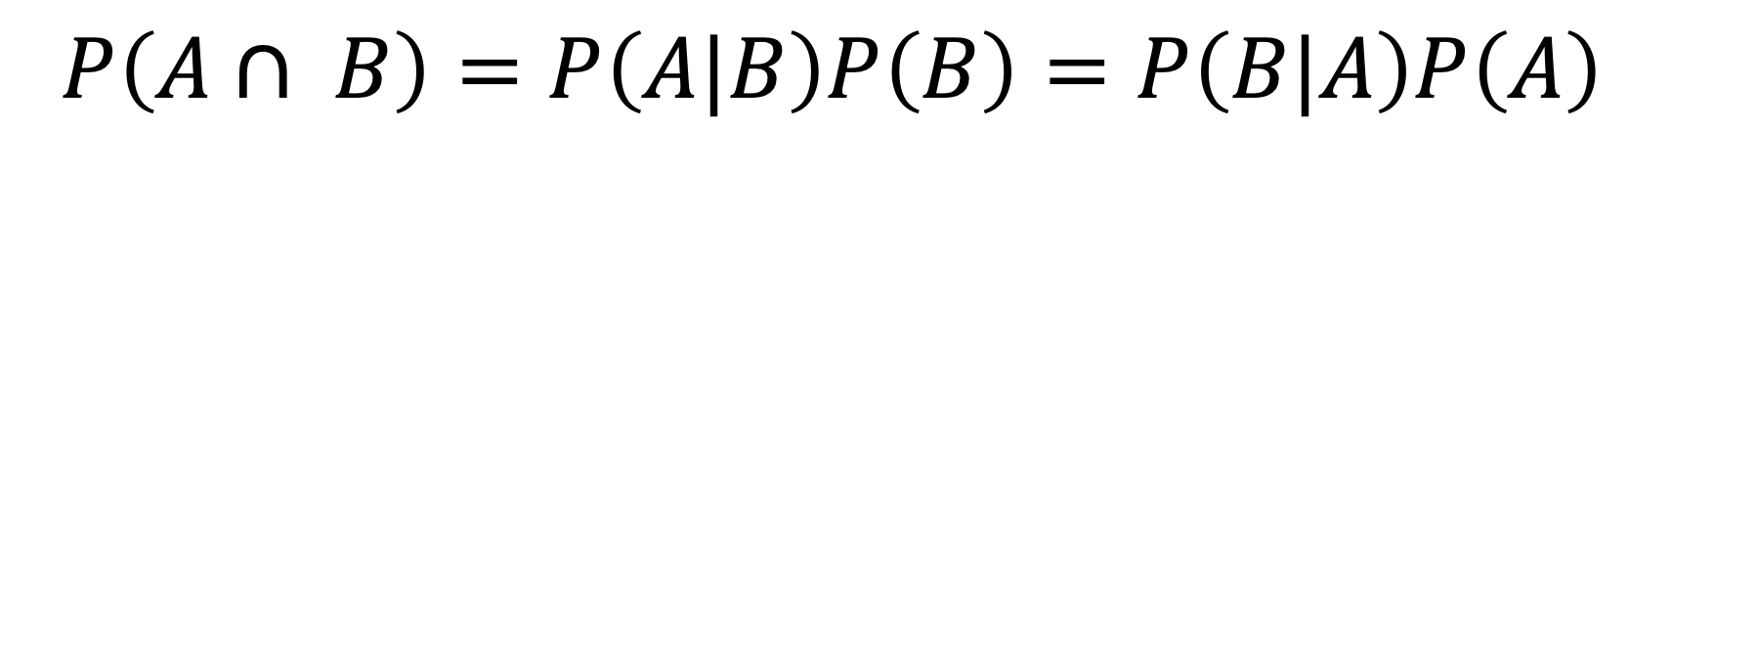
$$P\left(A∩ B\right)=P\left(A|B\right)P\left(B\right)=P\left(B|A\right)P\left(A\right)$$

Slide 17
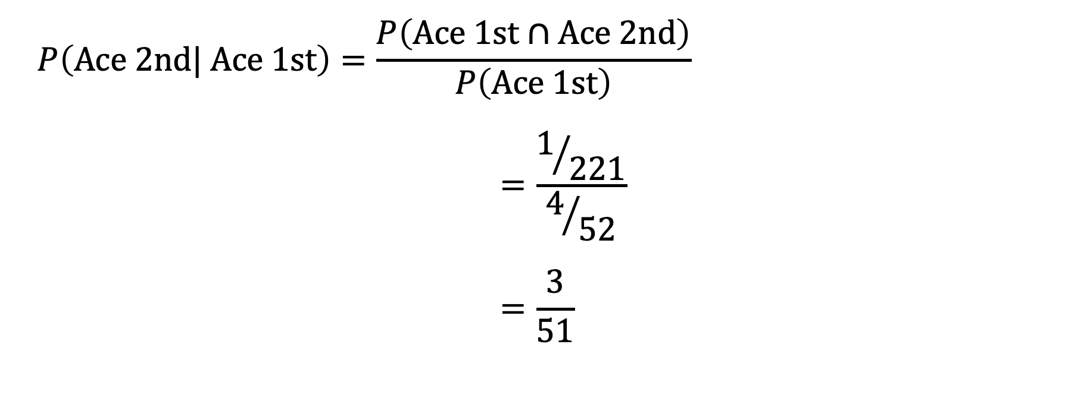
$$P\left(\text{Ace} 2nd| Ace \text{1}\text{st}\right)=\frac{P\left(A\text{ce} \text{1}\text{st}∩\text{Ace} 2nd\right)}{P\left(Ace \text{1}\text{st}\right)}$$
$$=\frac{1/{221}}{4/{52}}$$
$$=\frac{3}{51}$$

Slide 18
The Monty Hall problem
Suppose you’re on a game show and you’re given the choice of three doors: Behind one door is a car; behind the others, goats. You pick a door, say No. 1, and the host, who knows what’s behind the doors, opens another door, say No. 3, which has a goat. He then says to you, “Do you want to pick door No. 2?” Is it to your advantage to switch your choice?

Slide 19
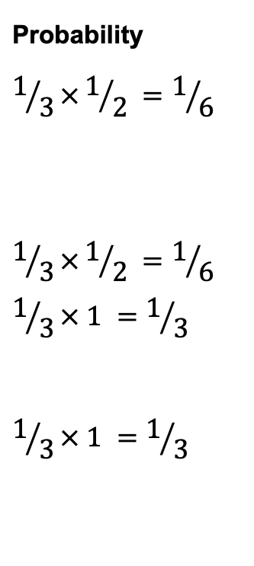
Probability
$$1/3×1/2 =1/6$$
$$1/3×1/2 =1/6$$
$$1/3× 1 =1/3$$
$$1/3× 1 =1/3$$
Door 2
1/2
Door 1
Host opens
1/3
1/2
Door 3
Car location
1/3
Door 2
Host opens
1
Door 3
1/3
Door 3
Host opens
1
Door 2

Slide 20
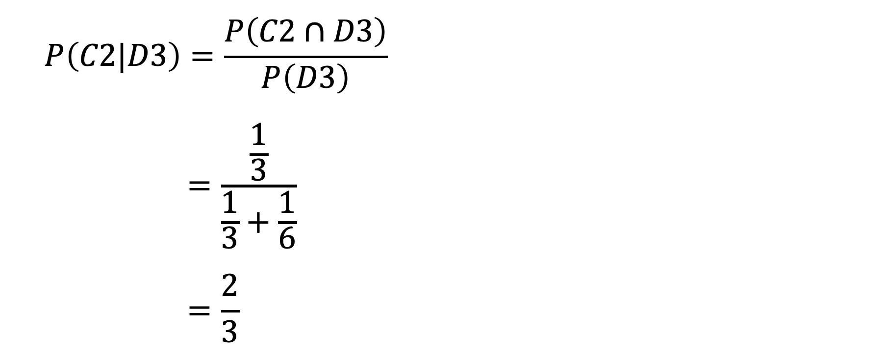
$$P\left(C2|D3\right)=\frac{P\left(C2∩D3\right)}{P\left(D3\right)}$$
$$=\frac{\frac{1}{3}}{\frac{1}{3}+\frac{1}{6}}$$
$$=\frac{2}{3}$$

